Slide 1
Network+ Guide to Networks Eighth Edition
Chapter 2
Network Infrastructure and Documentation
© 2019 Cengage. All Rights Reserved. May not be copied, scanned, or duplicated, in whole or in part, except for use as permitted in a license distributed with a certain product or service or otherwise on a password-protected website for classroom use.

Slide 2
Objectives
2.1 Identify and describe network and cabling equipment in commercial buildings and work areas
2.2 Create and analyze network diagrams
2.3 Explain operating procedures, inventory management, labeling conventions, and business documents for a typical network
2.4 Track the progress of changes made to a network

Slide 3
Components of Structured Cabling
T I A/E I A’s joint 568 Commercial Building Wiring Standard:
Also known as structured cabling
Describes the best way to install networking media to maximize performance and minimize upkeep
Apply no matter what type of media, transmission technology, or networking speeds are involved
Based on hierarchical design and assumes a network is based on the star topology

Slide 4
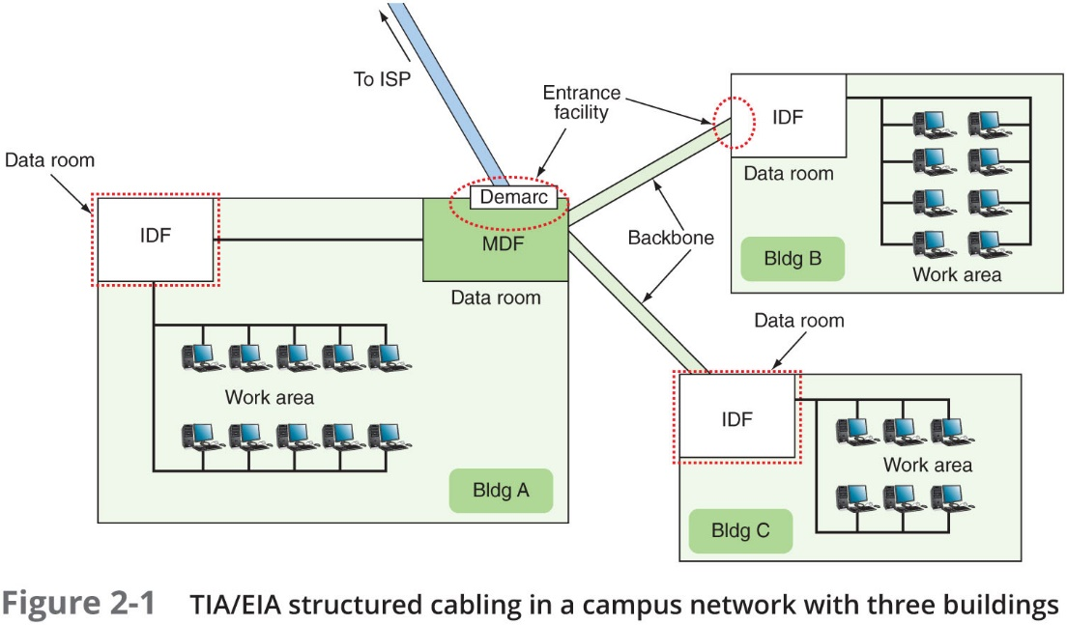
From the Demarc to a Workstation (1 of 10)
MDF – Main Distribution Frame
IDF – Intermediate Distribution Frame

Slide 5
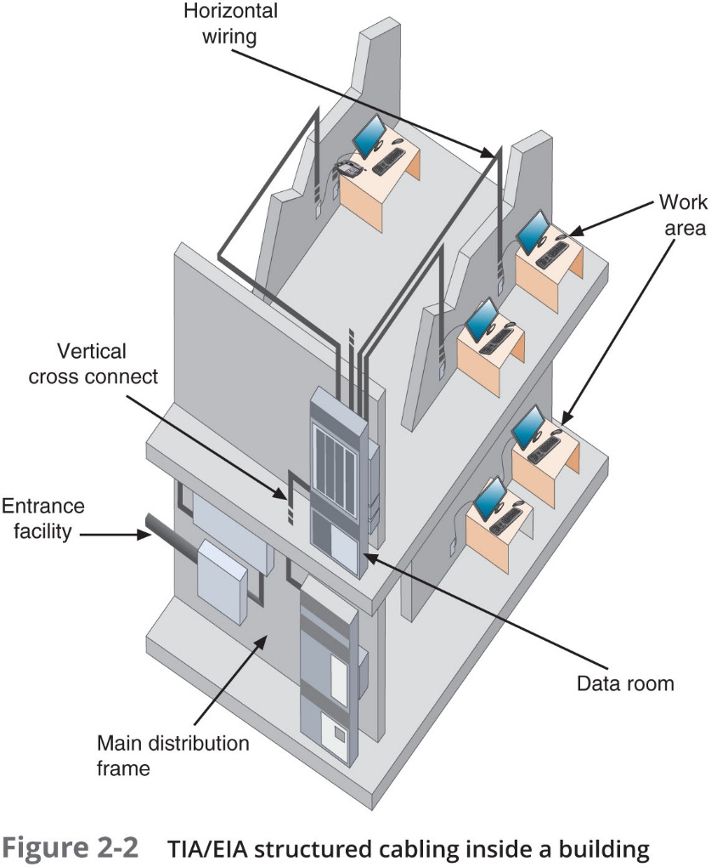
From the Demarc to a Workstation (2 of 10)
MDF – Main Distribution Frame
IDF – Intermediate Distribution Frame

Slide 6


From the Demarc to a Workstation (3 of 10)
Data rooms, racks, and other equipment:
Entrance Facility (EF)—Incoming network (such as Internet) connects with the school or corporate network
Demarc (demarcation point)—Device that marks where a telecommunications service provider’s network ends and the organization’s network begins
M D F (Main Distribution Frame/facility)—Centralized point of interconnection for an organization’s LAN or WAN (also called M C or main cross connect)
Data room—Enclosed space that hold network equipment (also called data closet, data center, equipment room, or telecommunications room)
Racks—Holds various network equipment
Patch panel—Panel of data receptors that can be mounted to a
wall or a rack
Provides central termination point when many patch cables converge in
a single location

Slide 7
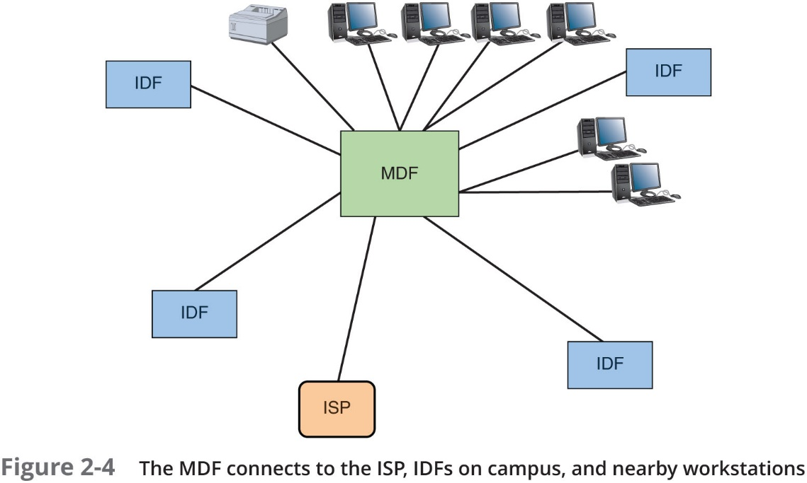
From the Demarc to a Workstation (4 of 10)
MDF – Main Distribution Frame
IDF – Intermediate Distribution Frame
ISP – Internet Service Provider

Slide 8
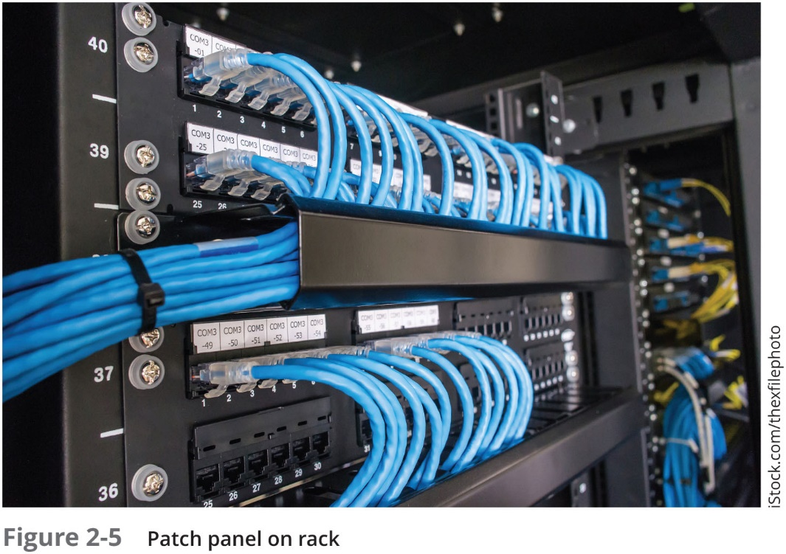
From the Demarc to a Workstation (5 of 10)

Slide 9
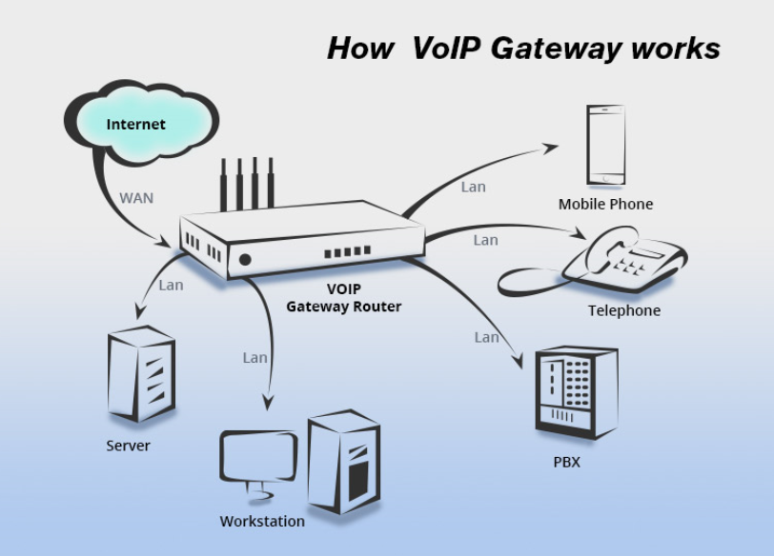

Slide 10
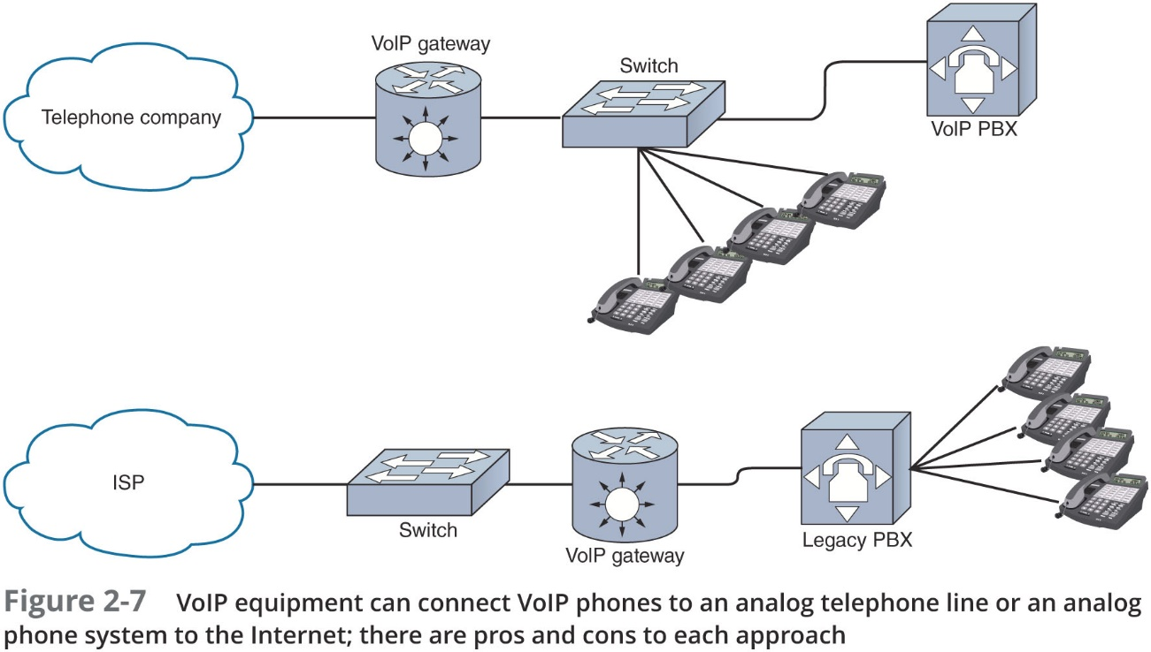
From the Demarc to a Workstation (7 of 10)

Slide 11

From the Demarc to a Workstation (6 of 10)
Data rooms, racks, and other equipment (continued):
V o I P telephone equipment—Voice over I P is the use of any network to carry voice signals using T C P/I P protocols
V o I P gateway
V o I P P B X
V o I P endpoints
I D F (Intermediate Distribution Frame)—Provides an intermediate connection between the M D F and end-user equipment on each floor and in each building
Work area—Encompasses workstations, printers, and other network devices
Wall jacks—T I A/E I A standard calls for each wall jack to contain at least one voice and one data outlet

Slide 12
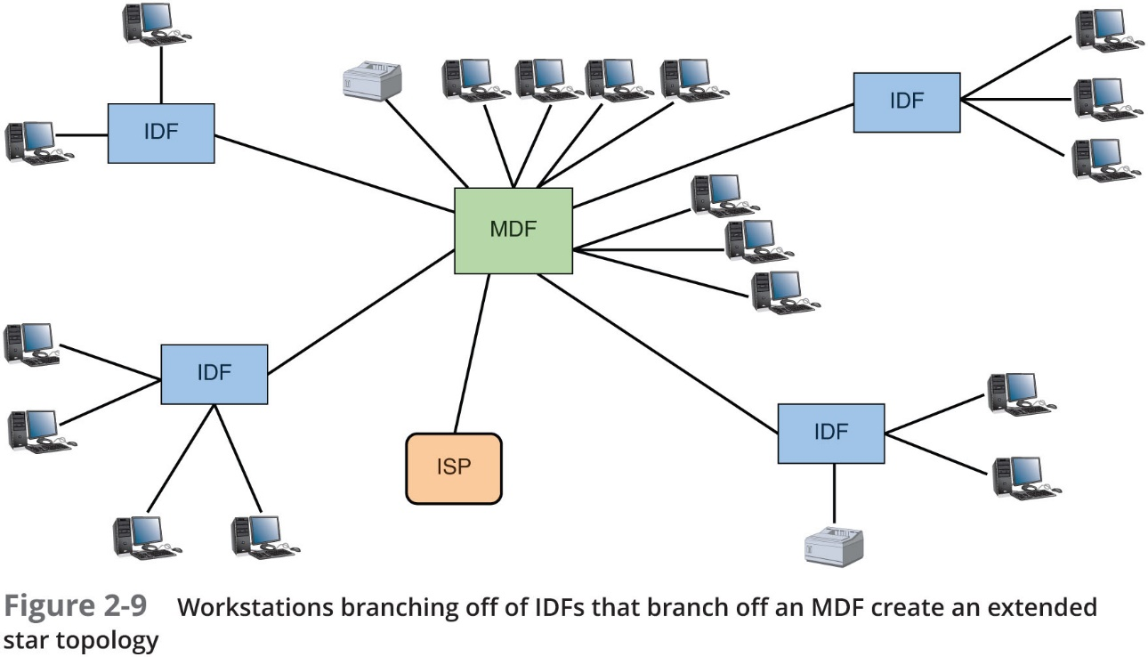
From the Demarc to a Workstation (8 of 10)

Slide 13
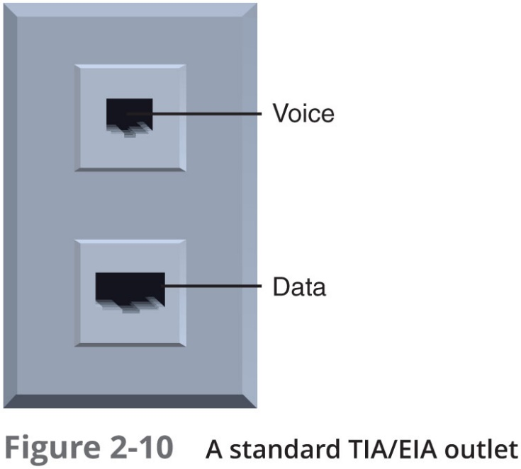
From the Demarc to a Workstation (9 of 10)

Slide 14
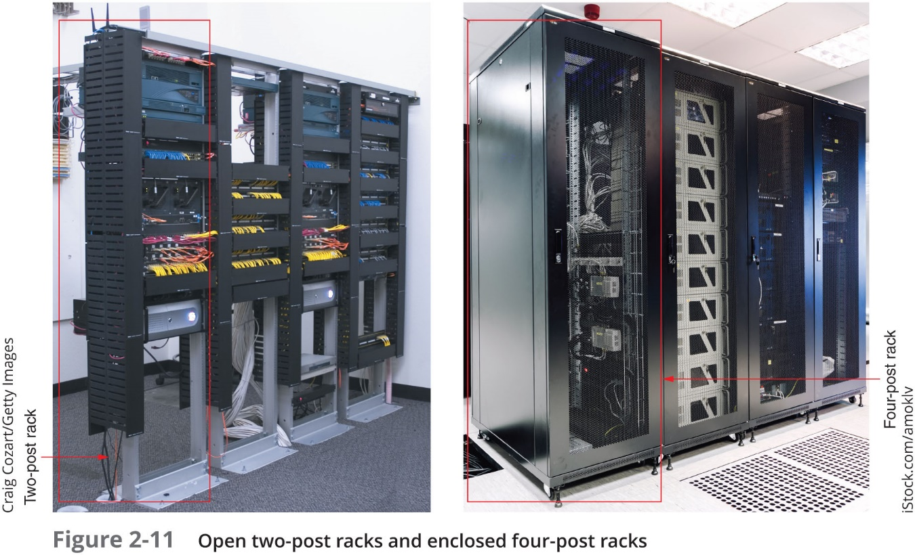
From the Demarc to a Workstation (10 of 10)
Rack systems

Slide 15
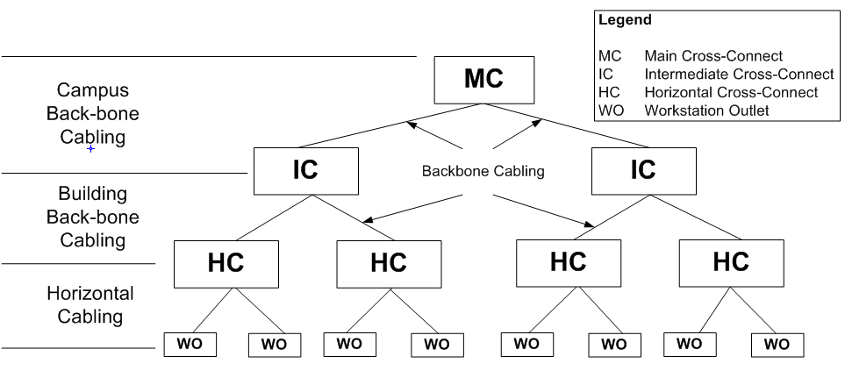
Terminology of Cabling & Cabling Devices (excluding spaces and rooms)
Main
Building
Floor

Slide 16
Cabling (1 of 6)
Types of cables:
Patch cable—A relatively short length of cabling with connectors at both ends
Horizontal Cabling (HC)—Connects workstations to the closest data room and to switches housed in the room
Backbone Cabling—Consists of cables or wireless links that provide interconnection between the entrance facility and M D F and between M D F and I D Fs

Slide 17
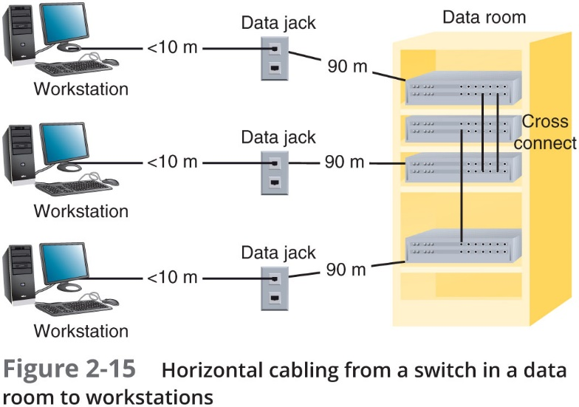
Cabling (2 of 6)
Total of 100 m

Slide 18

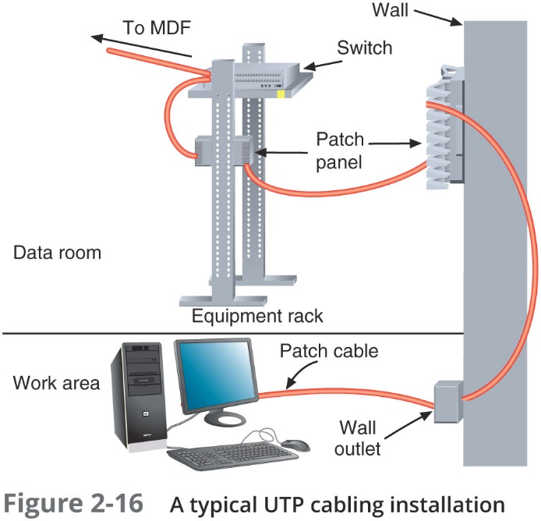
Cabling (3 of 6)

Slide 19
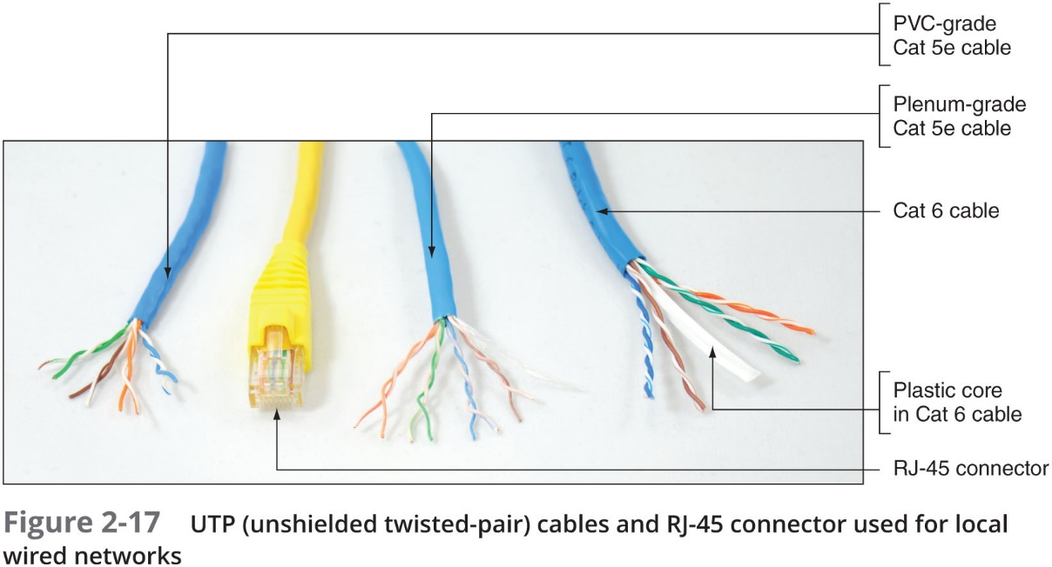
Cabling (4 of 6)
Cat 5e
Cat 6

Slide 20
Cabling (5 of 6)
Cable management:
When terminating twisted-pair cabling, don’t leave more than 1 inch of exposed cable before a termination
Do not exceed the cable’s prescribed bend radius (radius of the maximum arc into which you can loop a cable without impairing data transmission)
Use a cable tester to verify continuity (each cable segment transmits data reliably)
Cinch cables loosely
Protect cables—avoid laying cables across a floor and use cord covers if they must be exposed
Avoid E M I—Electromagnetic interference
Make sure cable sheath is plenum-rated

Slide 21

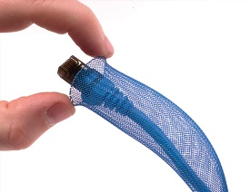
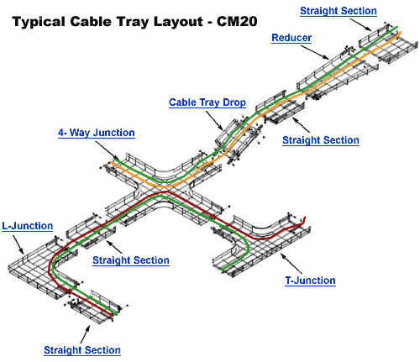
Cabling (6 of 6)
Cable management:
Pay attention to grounding requirements
Leave some slack in cable runs
Use cable management devices such as cable trays, braided sleeving, and furniture grommets
Use patch panels to organize and connect lines
Use company standards and stock
Documentation:
Keep your cable plant documentation accessible
Label every data jack or port, patch panel, and connector
Use color-coded cables for different purposes
Update your documentation as you make changes to the network

Slide 22
Monitoring the Environment and Security
Data rooms are often serviced by H V A C systems that are separate from the rest of the building
Specialized products can monitor the critical factors of a data closet’s environment:
Unacceptable temperature
Humidity
Airflow conditions
Every data room should be locked with only limited I T personnel having keys
Security cameras are suggested

Slide 23
Network Documentation
Having up-to-date and detailed documentation of your network is essential for the following reasons:
Makes communication with coworkers more efficient
Speeds up troubleshooting efforts
Puts information at your fingertips when facing similar problems in the future

Slide 24
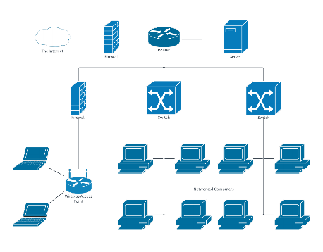
Network Diagrams (1 of 7)
Network Diagrams—Graphical representations of a network’s devices and connections
May show physical layout, logical topology, I P address reserves, names of major network devices, and types of transmission media
Network Mapping—The process of discovering and identifying the devices on a network:
Nmap—One of the most popular tools used for network mapping
Zenmap—N map’s G U I option
Cisco Systems set the standard for diagram symbols used to represent network devices

Slide 25
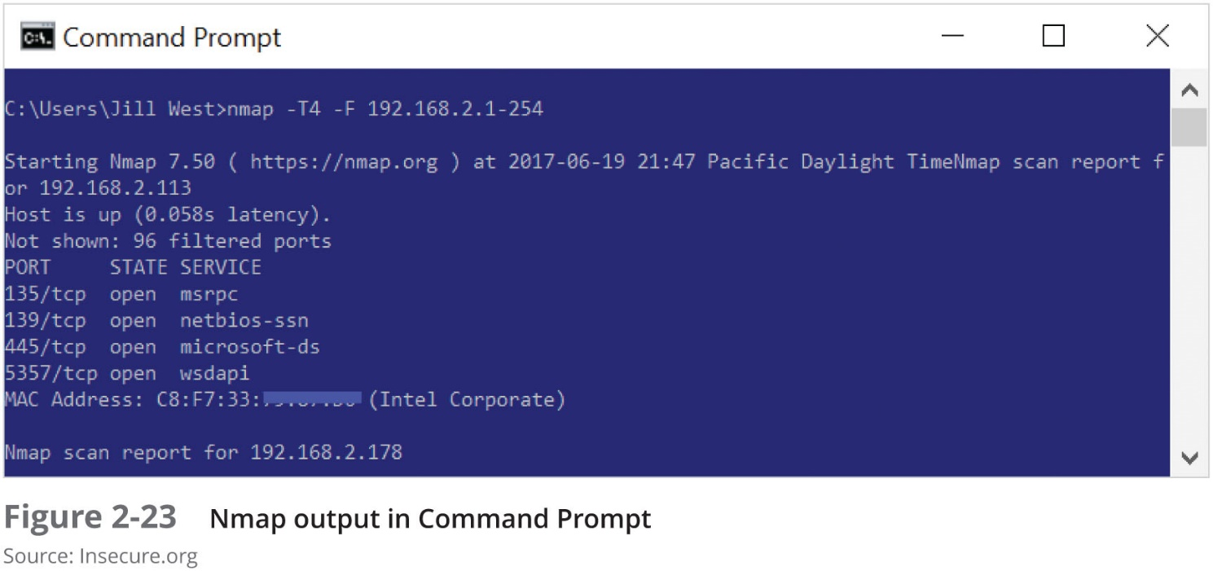
Network Diagrams (2 of 7)
Result of nmap scan showing ports that are open

Slide 26
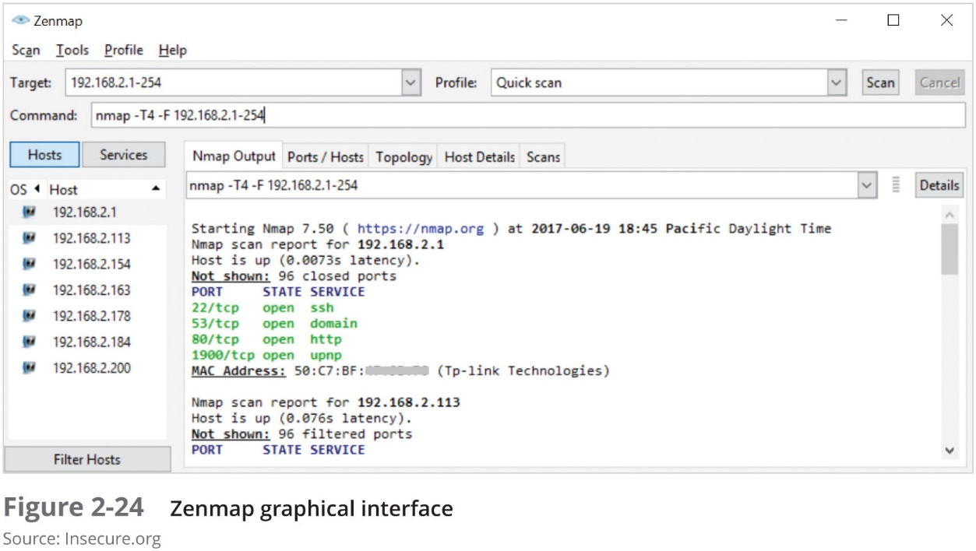
Network Diagrams (3 of 7)
Result of Zenmap scan showing ports that are open

Slide 27
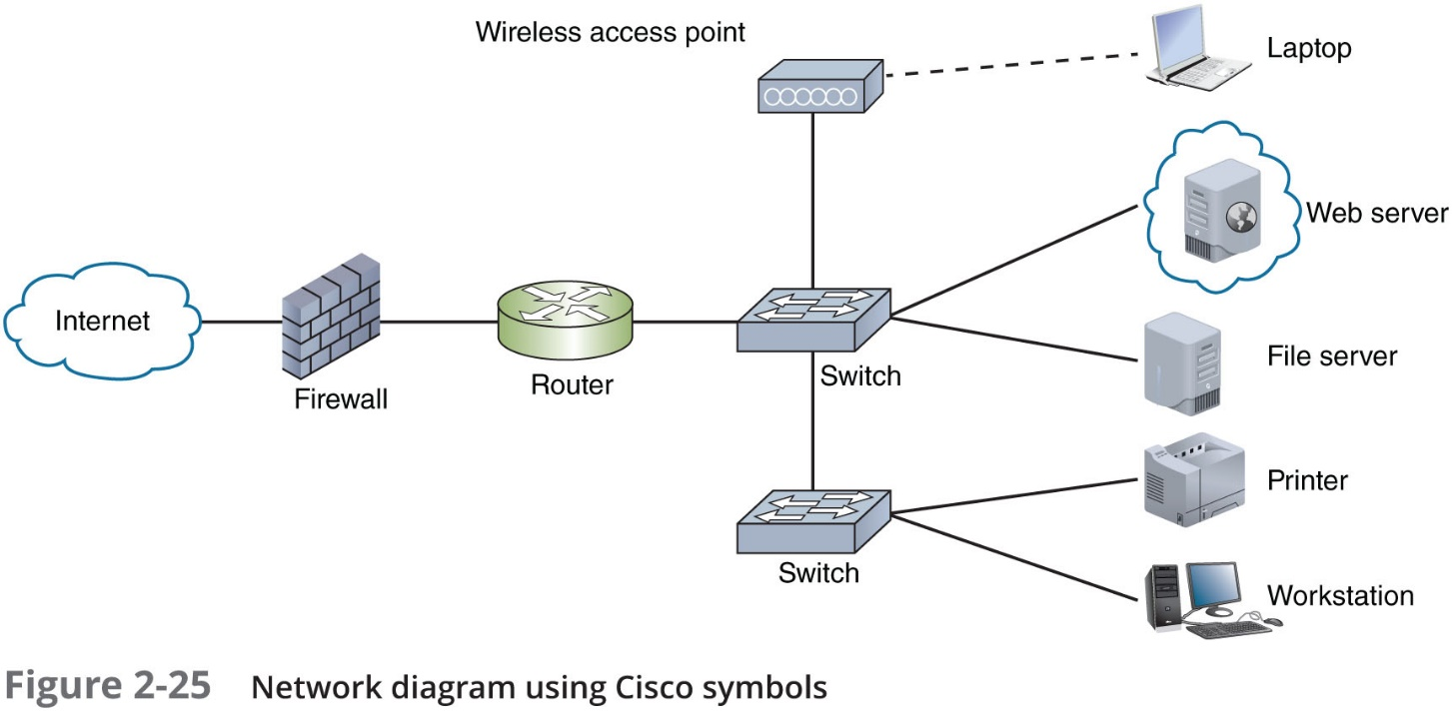
Network Diagrams (4 of 7)

Slide 28
Network Diagrams (5 of 7)
Network Diagrams provide broad snapshots of a network’s physical or logical topology
Useful for planning where to insert a new switch or determining how a particular router, gateway, or firewall interact
Wiring Schematic—A graphical representation of a network’s wired infrastructure
In detailed form, it shows every wire necessary to interconnect network devices
Rack diagram—Drawing that show devices stacked in a rack system

Slide 29
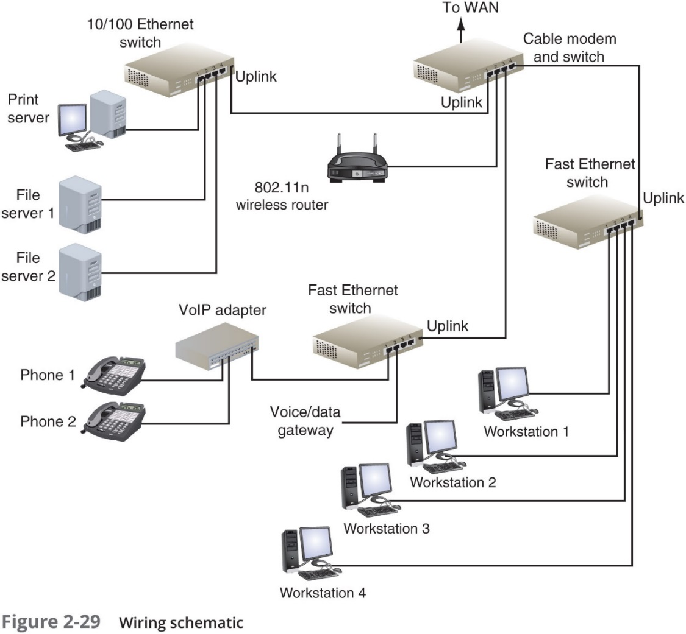
Network Diagrams (6 of 7)
WAN

Slide 30
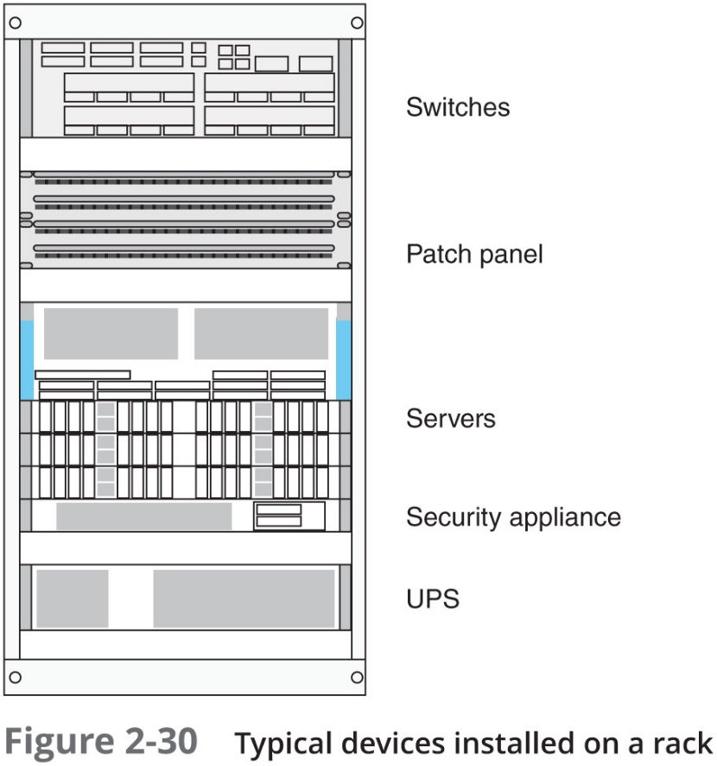
Network Diagrams (7 of 7)
Switches
Patch Panel
Servers
UPS

Slide 31
Operating Procedures
Essential documentation:
Logical and physical connections on a network
Inventory management
I P address utilization
Vendors
Internal operating procedures
Policies
Standards
An organization could provide an internal website or database to hold this information

Slide 32
Inventory Management
System Life Cycle (S L C)—Process of:
(A) designing,
(B) implementing, and
(C) maintaining an entire network
S L C includes:
(D) Removal and disposal of outdated assets
(E) Addition of compatible, updated devices
Inventory management—The monitoring and maintaining of all assets that make up a network:
Simplifies maintaining and upgrading a network
Provides network administrators with information about the costs and benefits of certain types of hardware or software

Slide 33
Labeling and Naming Conventions (1 of 2)
10 Tips for labeling and naming conventions:
Use names that are as descriptive as possible
Only include fields that are essential in identifying the device
Don’t overcomplicate the name with useless or redundant information
Use established naming conventions
Think big-picture-down-to-details
Consider any security risks from details included in your naming convention
Use color-coded cables for different purposes and use cable tags to identify each cable’s purpose
Label the ports and jacks that cables connect to
Where labels won’t fit on the device, draw a simple diagram of each device that indicates how each port is used
Use a portable label maker and use labels that are durable and are designed to stick to plastic and metal

Slide 34
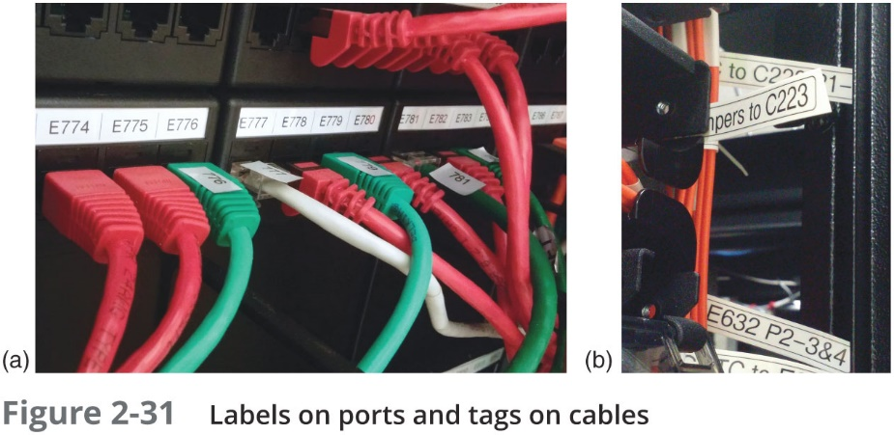
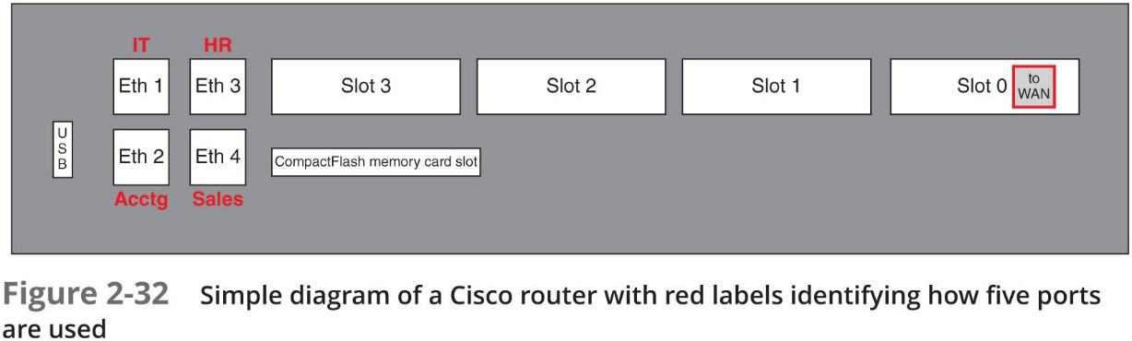
Labeling and Naming Conventions (2 of 2)

Slide 35
Business Documents (1 of 2)
Standard business documents you may encounter:
R F P (Request For Proposal)
Request to vendors to submit a proposal for a product or service your company wants to purchase
M O U (Memorandum Of Understanding)
Documents the intentions of two or more parties to enter into a binding agreement, or contract
S O W (Statement Of Work)
Documents in detail the work that must be completed for a particular project

Slide 36
Business Documents (2 of 2)
Standard business documents you may encounter (continued):
S L A (Service-Level Agreement)
A legally binding contract or part of a contract that defines the aspects of a service provided to a customer
Example: The service provided by an I S P
M S A (Master Service Agreement)
A contract that defines the terms of future contracts between parties
Such as payment terms or arbitration arrangements
M L A (Master License Agreement)
Grants a license from a creator, developer, or producer to a third party for the purposes of marketing or sublicensing, or distributing the product to consumers

Slide 37
Change Management
Managing change while maintaining network’s efficiency and availability:
Requires good planning
Network users need to know when to expect certain network resources to be unavailable
Common software and hardware changes
Range from installing patches to replacing network backbone
You may also need to know the change management documentation that might be required for an enterprise-scale network

Slide 38
Software and Hardware Changes (1 of 3)
Four (4) types of changes to existing software:
Patch
A correction, improvement, or enhancement
Upgrade
A major change to a software package that enhances the functionality and features of the software
Rollback
Also called backleveling or downgrading
Process of reverting to a previous version after attempting to patch or upgrade it
Installation
New software to be installed on relevant devices and incorporated with network resources
Hardware changes could include adding new security cameras, replacing workstations, installing new printers, and upgrading hardware

Slide 39
Software and Hardware Changes (2 of 3)
Table 2-3 Reversing a software upgrade
Type of upgrade | Options for reversing
Operating system patch | Use the patch’s automatic uninstall utility
Client software upgrade | Use the upgrade’s automatic uninstall utility, or reinstall the previous version of the client on top of the upgrade
Shared application upgrade | Use the application’s automatic uninstall utility, or maintain a complete copy of the previous installation of the application and reinstall over the upgrade
Operating system upgrade | Prior to the upgrade, make a complete backup of the system; to roll back, restore the entire system from the backup; uninstall an operating system upgrade only as a last resort

Slide 40
Software and Hardware Changes (3 of 3)
The same change management principles apply to any type of change:
Process all changes through the proper channels
Minimize negative impacts on business procedures
Plan thoroughly to maximize the changes of a successful change on the first attempt
Document each change throughout the process

Slide 41
Change Management Documentation
Generally, the larger an organization, the more documentation required when making changes
Required process will vary but expect the following:
Submit a change request document
Understand and follow the approval process
The change is project managed (change coordinator is usually assigned)
Provide additional documentation that could include:
Network configuration
IP address utilization
Additions to the network
Physical location changes
Close the change

Slide 42
Chapter Summary (1 of 3)
Organizations tend to follow a single cabling standard known as T I A/E I A-568 Commercial Building Wiring Standard or structured cabling
A network begins at the demark and ends at a workstation
Horizontal cabling connects workstations to the closest data room and to switches housed in that room
The backbone consists of the cables or wireless links that provide interconnection between the entrance facility and M D F, and between the M D F and I D Fs
Data rooms are often serviced by H V A C systems that are separate from the rest of the building
Specialized products are available that monitor the critical factors of a data room’s environment

Slide 43
Chapter Summary (2 of 3)
Network diagrams may show physical layout, logical topology, I P address reserves, names of major network devices, and types of transmission media
Inventory management simplifies maintaining and upgrading the network chiefly because you know what the system includes
The secret to keeping track of devices is naming them systematically and then labeling them with those names
It’s important to understand the specifics covered—and not covered—in a particular document before signing it
Four types of software changes include a patch, upgrade, rollback, and installation

Slide 44
Chapter Summary (3 of 3)
Typical hardware changes include adding new security cameras, replacing old workstations, installing new printers, and upgrading I P phone hardware
Generally, the larger an organization, the more documentation is necessary when making hardware and software changes

